Slide 1
Employee Attrition

Slide 2
Introduction
Employee attrition refers to the gradual reduction in the workforce due to employees leaving the organization for various reasons, such as resignation, retirement, or termination. This phenomenon is a critical concern for businesses as it directly impacts organizational performance, productivity, and morale. High attrition rates can lead to increased recruitment and training costs, loss of experienced employees, disruption of team dynamics, and potential declines in customer satisfaction and company reputation. Understanding the factors contributing to employee attrition is essential for implementing effective retention strategies. By analyzing attrition data, organizations can identify trends and patterns, such as the departments with the highest turnover rates, the impact of demographic factors like age and gender, and the influence of job satisfaction and work-life balance. This insight allows businesses to address underlying issues, improve employee engagement, and foster a more stable and motivated workforce, ultimately enhancing organizational success and sustainability.

Slide 3
Details of Data
Monthly income
numcompanieswork(number)
over18(Y)
percent salary hike
standard hours
Stockoptionlevel
Total working years
Training times last year
years at company
Years since last promotion
years with currmanager
Environment satisfaction(number)
job satisfaction(number)
worklife balance (number)
job involvement (number)
performance rating
Employee ID(number)
Age(number)
Attrition(Yes,No)
Business Travel(Travel_Rarely,Travel_Frequently,Non-Travel)
Department(Sales,Research&Development)
Distance from home(numbers)
Education(numbers)
Educational field(life sciences,other,medical)
Employee count(1)
Gender(Female,male)
joblevel(number)
Jobrole(healthcare representer,research scientist,
sales executive,human resources,laboratory technician,
manager,research director,manufacturing director)
Martinal status(Married,single)

Slide 4
Main KPI’s
Attrition Rate
Monthly income
Employee count
age
department
Attrition Rate by Job Role
Job Satisfaction and Environment Satisfaction
Marital status

Slide 5
Details of Dashboard
1 Marital Status of Employees:
Highest number of employees are married (1,060.19).
2 Department-wise Employee Distribution:
Largest department has approximately 6,959.2 employees.
3 Attrition as per Education Levels and Fields:
Medical field shows the highest variation in attrition rates.
4 Count of Employees as per Age:
Age group 35 has the highest number of employees.
5 Percentage of Total Income based on Attrition:
Majority of income comes from employees who did not attrite (1,051).
6 Additional Metrics:
Total number of employees: 3,25,879.
Each chart provides a different perspective on the employee data, such as marital status, department distribution, age distribution, education level, and attrition rates. This comprehensive analysis helps in understanding the factors influencing employee attrition and their distribution within the organization.

Slide 6
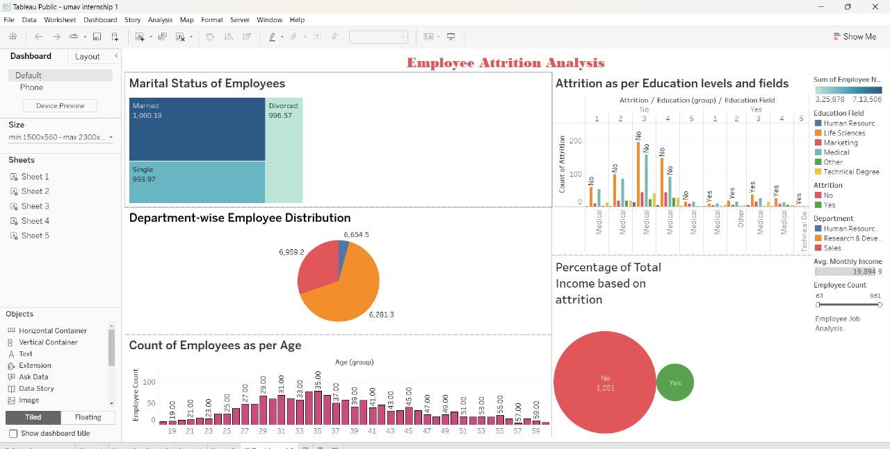
My Design

Slide 7
Thank you!

